Slide 1
SQL PROJECT ON PIZZA SALES

Slide 2
About the project
In the modern digital age, data is a crucial asset for businesses to make informed decisions and drive growth. One of the key areas where data analysis plays a significant role is in the food and beverage industry. This project focuses on utilizing SQL (Structured Query Language) to analyze pizza sales data, providing valuable insights that can help optimize business operations, enhance customer satisfaction, and boost profitability.

Slide 3

Project insights

Slide 4


Retrieve the total number of orders placed.
QUERY
OUTPUT

Slide 5
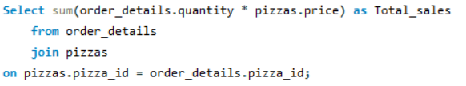

Calculate the total revenue generated from pizza sales.
QUERY
OUTPUT

Slide 6
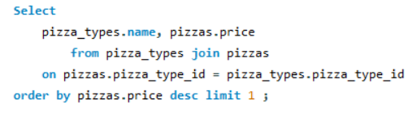

Identify the highest-priced pizza.
QUERY
OUTPUT

Slide 7
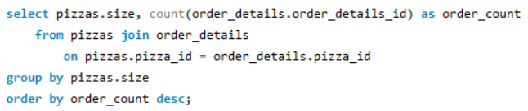
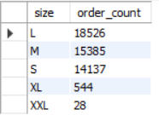
Identify the most common pizza size ordered.
QUERY
OUTPUT

Slide 8
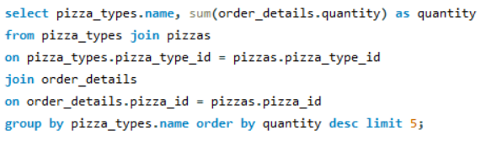
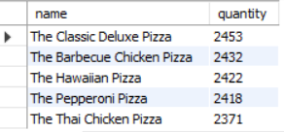
List the top 5 most ordered pizza types along with their quantities.
QUERY
OUTPUT

Slide 9
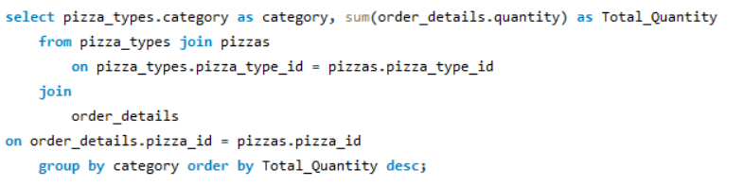
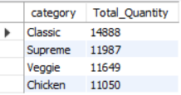
Join the necessary tables to find the total quantity of each pizza category ordered
QUERY
OUTPUT

Slide 10

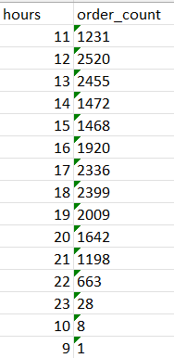
Determine the distribution of orders by hour of the day
QUERY
OUTPUT

Slide 11
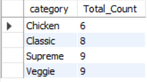
Join relevant tables to find the category-wise distribution of pizzas
QUERY
OUTPUT

Slide 12
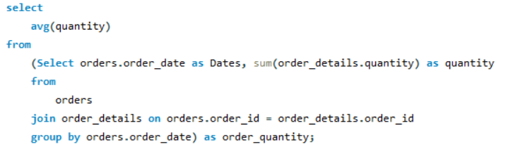

Group the orders by date and calculate the average number of pizzas ordered per day
QUERY
OUTPUT

Slide 13
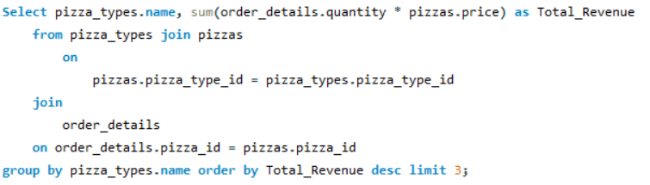
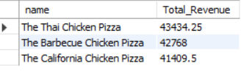
Determine the top 3 most ordered pizza types based on revenue
QUERY
OUTPUT

Slide 14
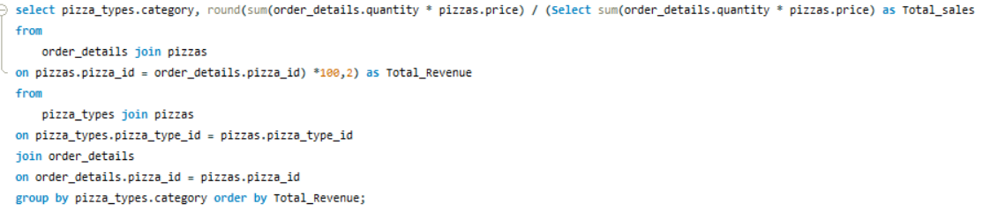
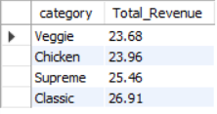
Calculate the percentage contribution of each pizza type to total revenue
QUERY
OUTPUT

Slide 15
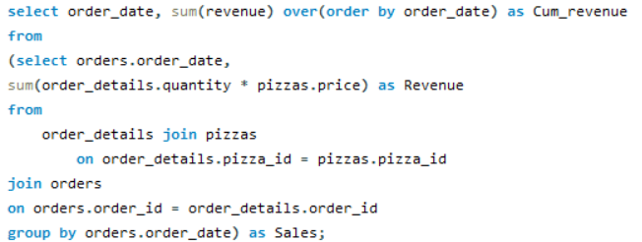
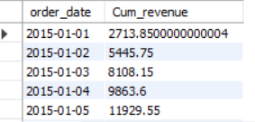
Analyze the cumulative revenue generated over date
QUERY
OUTPUT
And more

Slide 16
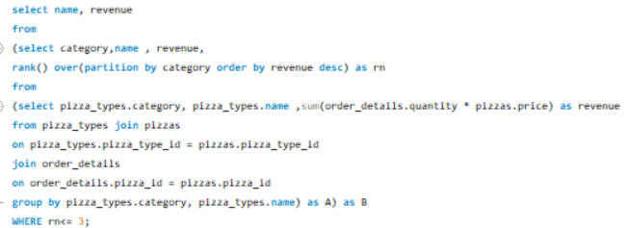
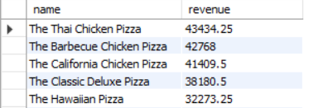
Determine the top 3 most ordered pizza types based on revenue for each pizza category
QUERY
OUTPUT

Slide 17

Thank you
Tarun Kumar Kushwaha
tkushwaha47@gmail.com

